Slide 1
The Respiratory System
LIFE PROCESSS CLASS -X

Slide 2
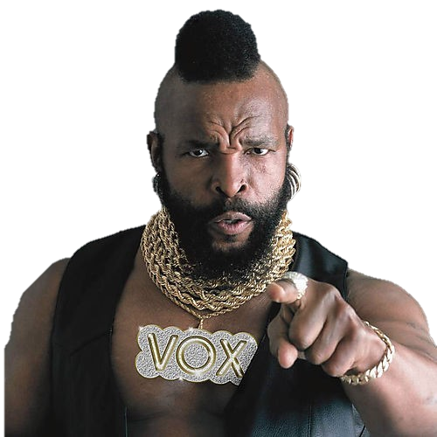
I pity the fool who thinks breathing is respiration.
MrT says…

Slide 3
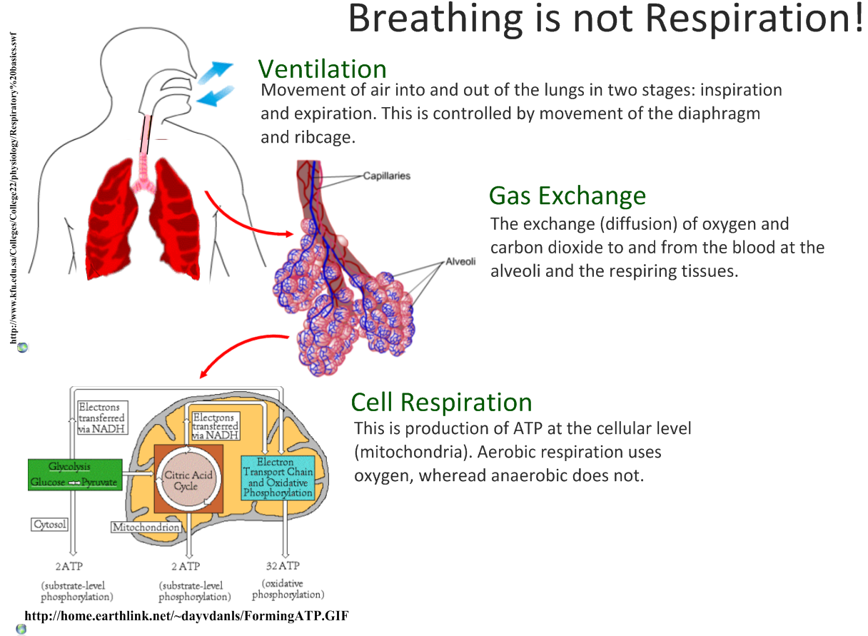

Slide 4
Breathing
Sequence of events that results in gas exchange.
In terrestrial vertebrates it includes 3 steps:
1. Ventilation: Inspiration and
expiration.
2. External respiration: Gas exchange
between air (in lungs) and blood.
Blood then transport Oxygen to the
body tissue cells.
3. Internal respiration: Gas exchange
between blood and tissue fluid.
Blood then transports carbon
dioxide to the lungs.

Slide 5
Respiraton
Break down of glucose into carbondioxide, water and energy in presence of various enzyme is called respiration
Glucose + O₂ ATP + H₂O + CO₂
Diverse organisms do this in different ways – some use oxygen to break-down glucose completely into carbon dioxide and water, some use other pathways that do not involve oxygen.
It is of two types
  1. Anaerobic respiration and
  2.Aerobic respiration

Slide 6
Types of Respiraton
The process takes place in the absence of air (oxygen)is called anaerobic respiration.
The process takes place in the presence of air (oxygen) is called aerobic respiration.
In all cases, the first step is the break-down of glucose, a six-carbon molecule, into a three-carbon molecule called pyruvate.
This process is called Glycolysis and takes place in the cytoplasm of a cell.

Slide 7
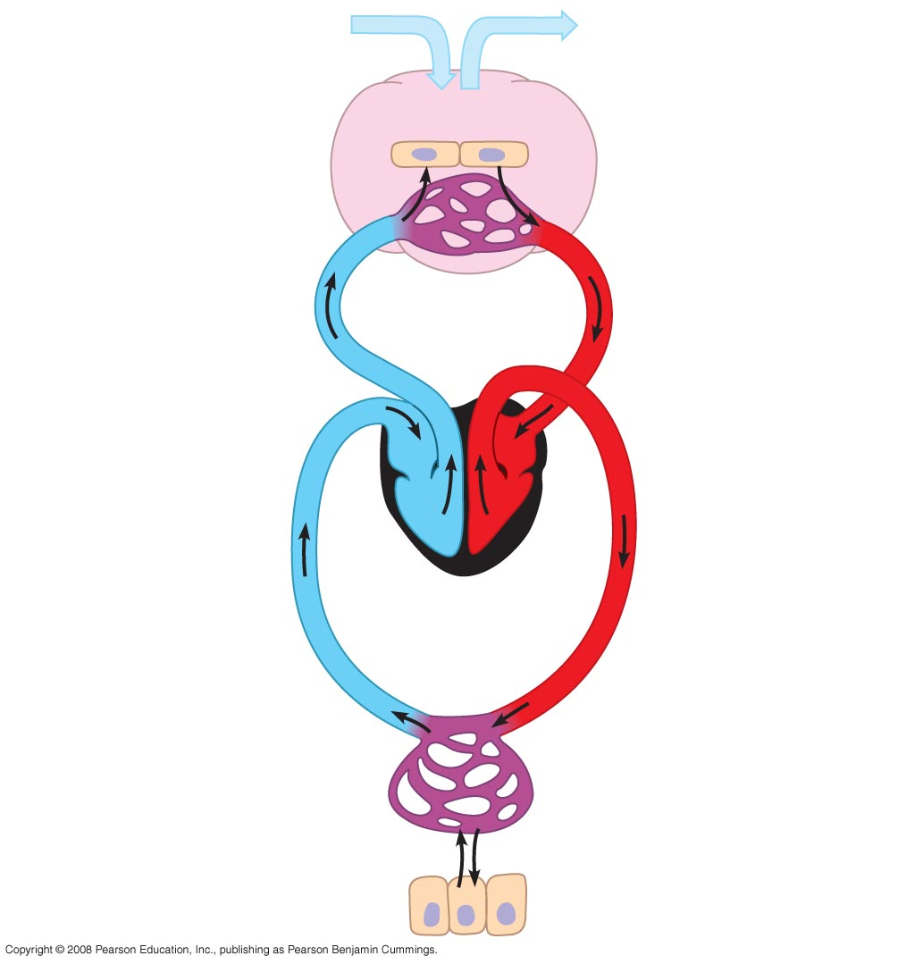
Gas exhange surface must be:
Moist
Thin
Large in relation of size of body
Alveoli filled with air (gas)
External respiration
Carbon dioxide
oxygen
Blood – part of circulatory system contain red pigment – hemoglobin, to transport gasses
Process: Diffusion of gasses (oxygen and carbon dioxide
Internal respination
oxygen
Carbon dioxide
Body cells surrounded by tissue fluid

Slide 8
1.Anaerobic Respiraton
On the basis of absence and lack of oxygen anaerobic respiration may of two types-
  A. Absence of oxygen-The pyruvate may be converted into ethanol and carbon dioxide. This process takes place in yeast during fermentation.
  B.Lack of oxygen-Sometimes, when there is a lack of oxygen in our muscle cells, another pathway for the break-down of pyruvate is taken. Here the pyruvate is converted into lactic acid which is also a three-carbon molecule. This build-up of lactic acid in our muscles during sudden activity causes cramps.

Slide 9
2.Aerobic Respiraton
In presence of oxygen the pyruvate converted into carbon dioxide, water and energy is called aerobic respiration .
This takes place in mitochondria and name the cycle takes place in it is called Krebs Cycle.
In mitochondria huge amount of energy is librated and it is also called power house of cell.

Slide 10
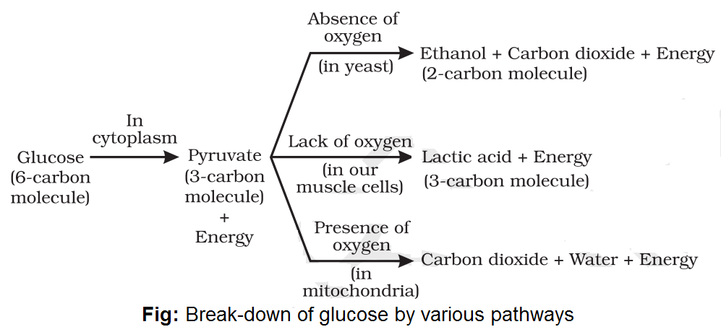

Slide 11
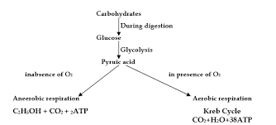

Slide 12
Adenosine Triphosphate(ATP)
The energy released during cellular respiration is immediately used to synthesise a molecule called ATP which is used to fuel all other activities in the cell.
In these processes, ATP is broken down giving rise to a fixed amount of energy which can drive the endothermic reactions taking place in the cell.

Slide 13
MORE TO KNOW ABOUT(ATP) !
ATP is the energy currency for most cellular processes. The energy released during the process of respiration is used to make an ATP molecule from ADP and inorganic phosphate.
Endothermic processes in the cell then use this ATP to drive the reactions.
When the terminal phosphate linkage in ATP is broken using water, the energy equivalent to 30.5 kJ/mol is released.
ATP can be used in the cells for the contraction of muscles, protein synthesis, conduction of nervous impulses and many other activities.

Slide 14
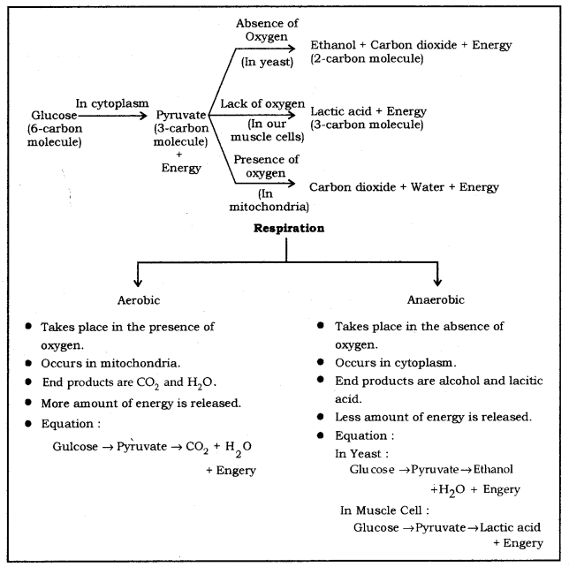

Slide 15
Human Respiratory System
In human beings , air is taken into the body through the nostrils.
The air passing through the nostrils is filtered by fine hairs that line the passage. The passage is also lined with mucus which helps in this process. From here, the air passes through the throat and into the lungs.
Rings of cartilage are present in the throat. These ensure that the air-passage does not collapse.

Slide 16
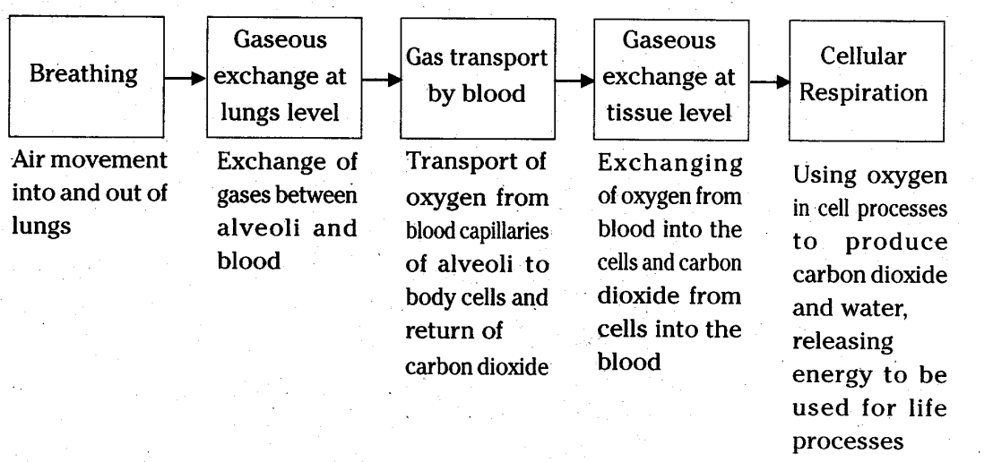

Slide 17
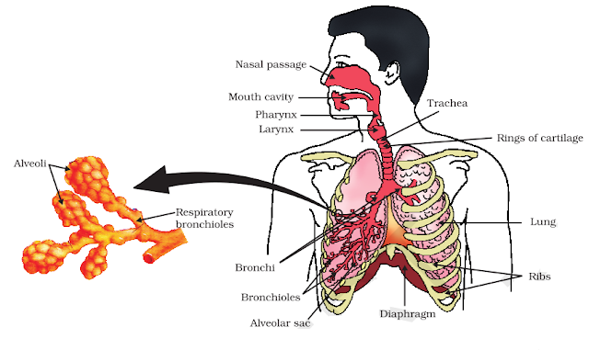

Slide 18
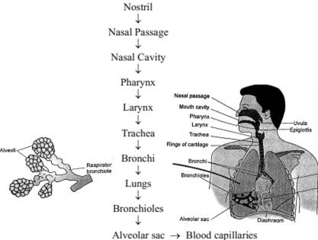

Slide 19
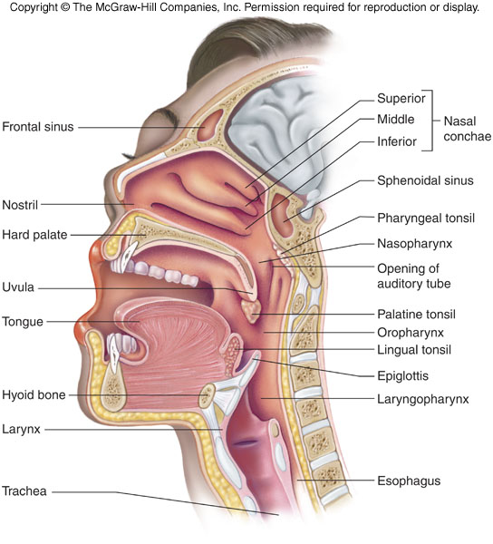
Divisions of the Respiratory System
Upper respiratory tract (outside thorax)
  Nose
  Nasal Cavity
  Sinuses
  Pharynx
Larynx

Slide 20
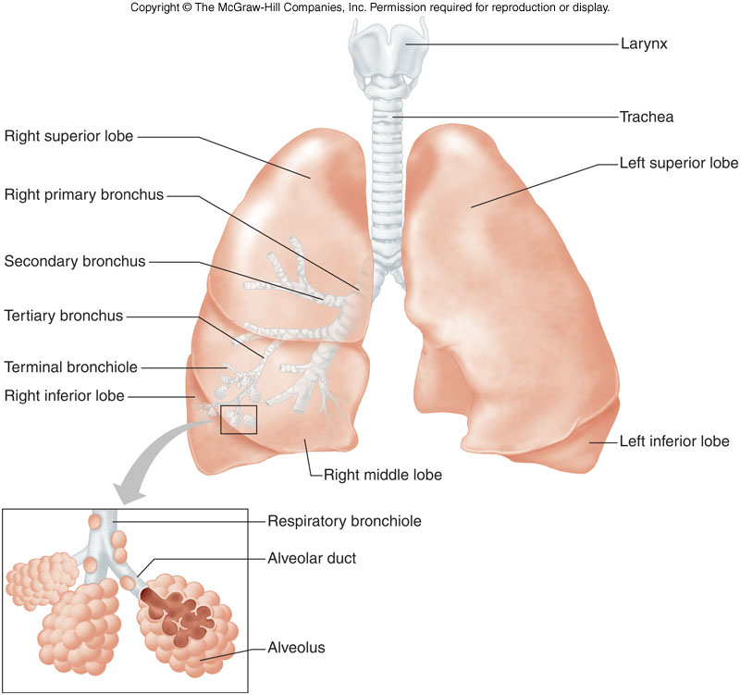
Divisions of the Respiratory System
Lower respiratory tract (within thorax)
  Trachea
  Bronchial Tree
  Lungs

Slide 21
Human Respiratory System
In human beings , air is taken into the body through the nostrils.
The air passing through the nostrils is filtered by fine hairs that line the passage. The passage is also lined with mucus which helps in this process. From here, the air passes through the throat and into the lungs.
Rings of cartilage are present in the throat. These ensure that the air-passage does not collapse.

Slide 22
Human Respiratory System
Within the lungs, the passage divides into smaller and smaller tubes which finally terminate in balloon-like structures which are called alveoli.
The alveoli provide a surface where the exchange of gases can take place.
The walls of the alveoli contain an extensive network of blood-vessels.

Slide 23
Structures of the Upper Respiratory Tract Pharynx Continued
Changes shape to allow for vowel sounds = phonation.

Slide 24
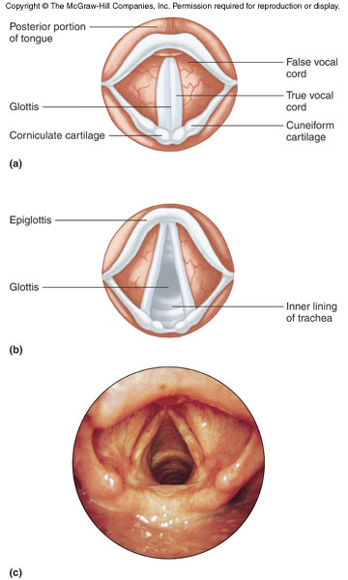
Structures of the Lower Respiratory Tract
Larynx - voice box
  Root of tongue to upper end of trachea.
  Made of cartilage
  2 pairs of folds
    Vestibular - false vocal cords
    True vocal cords

Slide 25
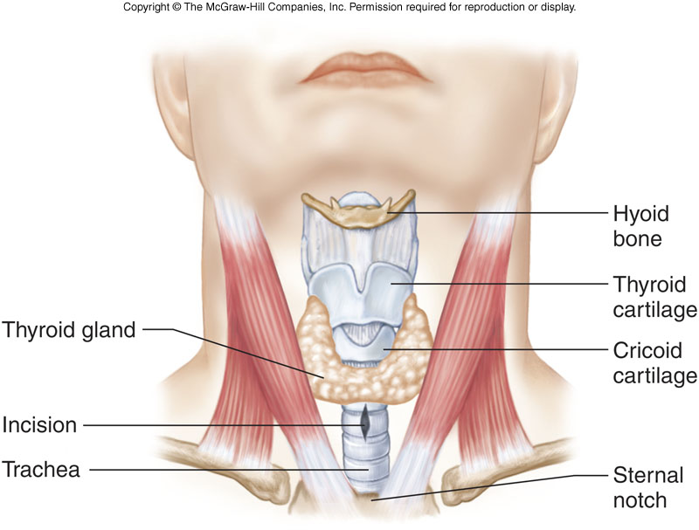
Structures of the Lower Respiratory Tract larynx cont…
Thyroid cartilage - adam’s apple - larger in males due to testosterone.
Epiglottis - flap of skin (hatch) on trachea, moves when swallowing and speaking.
  closes off trachea when swallowing food

Slide 26
Structures of the Lower Respiratory Tract
Trachea (windpipe)
  Larynx to bronchi
  Consists of smooth cartilage and C shaped rings of cartilage.
  Tracheostomy - cutting of an opening in trachea to allow breathing.

Slide 27
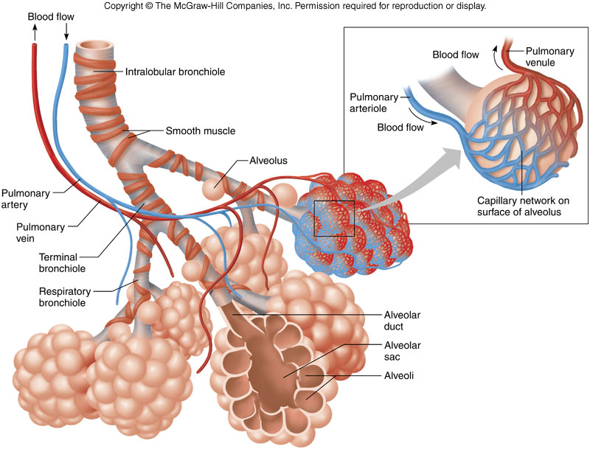
Structures of the Lower Respiratory Tract

Slide 28
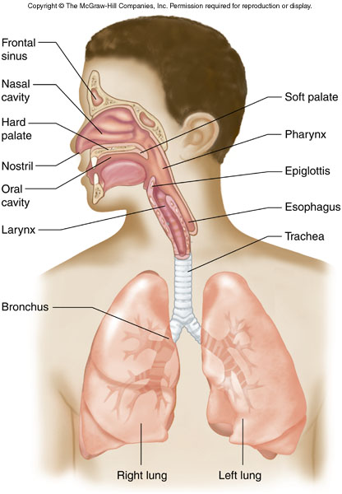
Structures of the Lower Respiratory Tract
Lungs
  Extend from diaphragm to clavicles
  Divided into lobes by fissures.
  Visceral pleura adheres to the lungs.
    Pleurisy = inflammation of the pleural lining

Slide 29
(Plural – bronchi)
Bronchioles

Slide 30
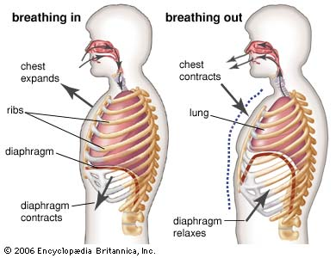
http://people.eku.edu/ritchisong/301notes6.htm

Slide 31
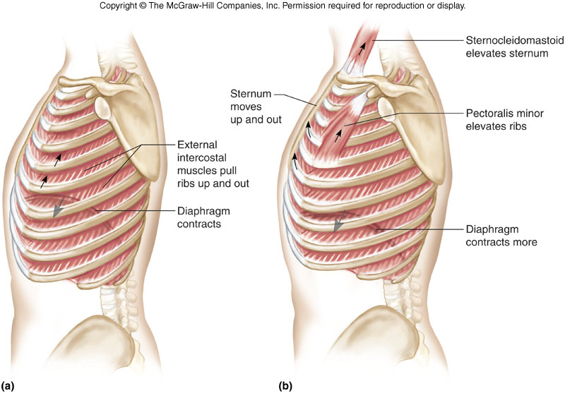
Inspiration
  -Contraction of diaphragm and intercostal muscles

Slide 32
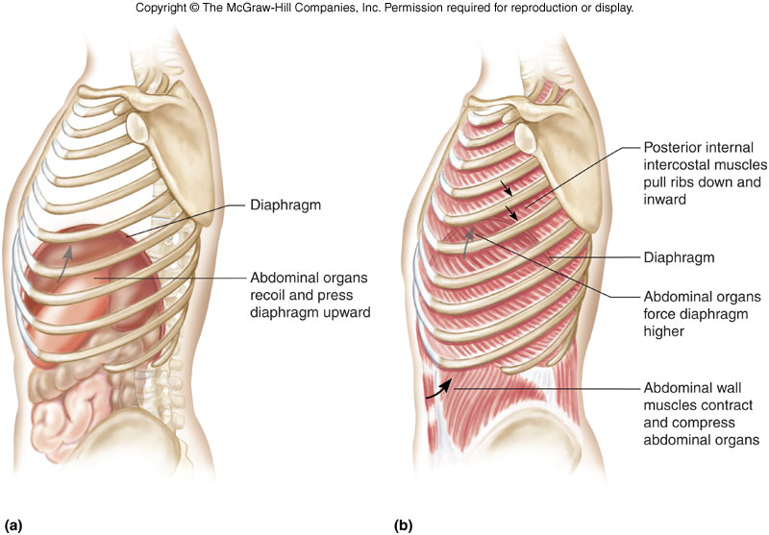
Expiration
Relaxation of diaphragm and intercostal muscles

Slide 33
Volumes of Air Exchange
Residual volume - amount of air that stays trapped in the alveoli (about 1.2 liters).

Slide 34
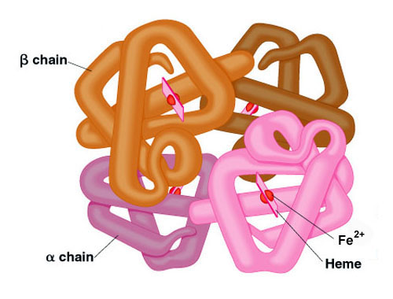
HEMOGLOBIN MOLECULE
Consist of 4 polypeptide chains (protein – 2 alpha and 2 beta).
Each chain is associated with a heme group.
Each heme group contains an iron atom.
Iron binds with oxygen.

Slide 35
HEMOGLOBIN MOLECULE
Respiratory pigments take up oxygen from the air in the lungs and carry it to tissues which are deficient in oxygen before releasing it.
In human beings, the respiratory pigment is haemoglobin which has a very high affinity for oxygen. This pigment is present in the red blood corpuscles.
Carbon dioxide is more soluble in water than oxygen is and hence is mostly transported in the dissolved form in our blood.

Slide 36
Exchange of gases- O₂
Most oxygen is transported by hemoglobin (red pigment protein in erythrocytes).
Oxygen combines with hemoglobin to form oxyhemoglobin.
Hb + O₂ = HbO₂
Hemoglobin Oxygen Oxyhemoglobin
A small amount of oxygen is transported in solution in the blood plasma.

Slide 37
Exchange of gases- CO₂
A small amount of carbon dioxide is transported by the Hemoglobin molecules in the form of carbaminohemoglobin (HbCO₂).
CO₂ + Hb = HbCO₂
The higher the amount of hydrogen ions in the blood the lower the pH. Therefor hydrogen ions bond with the globin part of Hb to keep the pH normal in the blood.

Slide 38
Functions of the Respiratory System
  Air Distributor
  Gas exchanger
  Filters, warms, and humidifies air
  Influences speech
  Allows for sense of smell

Slide 39
Review Questions
1 Which of the following is not a function of the respiratory system?
A. influence speech
B. Distribution of oxygen to cells
C. Filtration of air
D. Warming of air
B

Slide 40
2
The common name for the trachea is _______
Windpipe

Slide 41
3
The structure known as the Adam’s Apple located in neck is the _____
Thyroid Cartilage

Slide 42
4
The smallest branches of the bronchial tree are the
Primary bronchi
Secondary bronchi
Tertiary bronchi
Bronchioles
D

Slide 43
5
The flap or opening to the trachea is the
Larynx
Pharynx
Epiglottis
Vocal cords

Slide 44
6
The structure that separates the right and left nasal cavities is the ____________
Septum

Slide 45
7
The incorrect formation of the palantine bone during gestation is known as a __________
Cleft Palate

Slide 46
8
During inspiration which of the
following does not occur?
Diaphragm contracts
Intercostals relax
Diaphragm flattens
Size of thorax increases
B

Slide 47
9
Which of the following activities is the
best analogy of respiration?
Exchanging gifts
Giving a gift
Receiving a gift
Sitting in a chair
A

Slide 48
10
Air is forced into the lungs by the
contraction of the…
Alveoli
Bronchioles
Diaphragm
Heart
C

